Slide 1
Networkfleet®

Slide 2
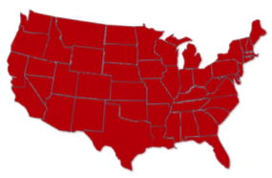
Networkfleet-Verizon History
AWARDS
1999 Founded
Dec. 2002 Acquired by Reynolds & Reynolds Co.
Aug. 2006 Acquired by HUGHES Telematics Inc.
July 2012 HUGHES acquired by Verizon
Jan. 2015
Management of Networkfleet split from VTI
VTI becomes part of VZ New Prod Mgmt
Headquartered in San Diego
80%
70%
2012 Winner
50 Issued and Pending Patents
Notes:
BACKGROUND:
Founded in 1999 via a MIT contest. The founder won, took the money as pursued the dream of startup.
Back then product was consumer facing...track your teen, monitor your car.
In 2002, R&R purchased Networkcar.
R&R is in the automotive ecosystem, they support auto dealerships.
R&R sold the NWC solution as part of the aftermarket sale.
In about 2003-2004, a customer approached Networkcar who had a business and a fleet of vehicles and inquired about building a fleet application.
NWC built the fleet application and that let to Networkcar becoming what is it today...a commercial fleet application.
In August of 2006, HTI purchased NWC to leverage the IP to build out it’s telematics platform, as EG described.
In July of 2012, VZ purchased HTI and it’s 4 business units.
NWF is based out of San Diego and has received it’s fair share of awards such as the 2012 Telematics Update Winner of Best Telematics Service or Solution for Commercial Vehicle
HTI also won for Best Telematics Service Provider Award
AWARDS:
Networkfleet - 2012 Winner - Telematics Update Awards, Best Telematics Service or Solution for Commercial Vehicle
HTI - Best Telematics Service Provider Award
http://analysis.telematicsupdate.com/other/telematics-update-awards-2012-winners-announced

Slide 3
Some of our Networkfleet Customers
State of California DOT
State of Virginia DOT
State of Arizona DOT
State of New Mexico DOT
State of New Hampshire DOT
State of Utah DOT
State of Wyoming DOT
State of Colorado DOT
State of Delaware
State of Vermont
City of Odessa
City of Arlington
City of Oklahoma City
City of Columbus
City of Oakland
City of Oxnard
City of NAPA
City of Reno
City of Virginia Beach
City of Chesapeake
City of Palo Alto
City of Oakland
City of Ventura
City of Colorado Springs
County of Contra Costa
County of San Diego
County of Sonoma
County of Sacramento
County of Alameda
County of Yolo
County of Washoe
Solano Irrigation District
Town of Greenwich
New York Power Authority
Baltimore Gas and Electric
St. Johns Water Mgmt District
NV Energy
East Bay MUD
Serco North America
Los Alamos National Laboratory
Ace Asphalt

Slide 4
Steps to Driver Acceptance
1. Communicate your goals for GPS to your employees
Driver Safety
Fuel & Maintenance Savings
Job Efficiencies
2. Positive communication and implementation
One-on-One conversation
Reinforce message
Driver of the Week
3. Follow through and accountability
Use reporting
Educational conversation
Share stories & savings
Notes:
* Now that you can see the benefits, its these benefits you communicate to your employees and here is how….

Slide 5
Government Purchasing Contracts
WSCA – Now called NASPO
GSA
NJPA

Slide 6
Telematics Technology Adoption
After 14+ years, telematics at about 25% penetration
Entering the Majority stage in which over 70% of buyers will make their purchase
Proverbial hockey stick
100%
2014
2010
24%
2000
2007
0%
Innovators
Early Adopters
Early Majority
Late Majority
Laggards
Source: Berg insight Fleet Management in the Americas – M2M Research Series 2013
C.J. Driscoll & Associates U.S. Mobile Resource Management Systems Market Study – August 2012
Notes:
Chart fades up 2 secs after click

Slide 7
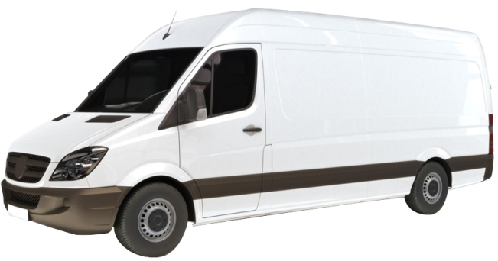
Fleet Challenges
Reduced cost
Cost
Lower impact
Environment
Regulations
Improved Safety
Safety
Compliant
Notes:
Introduction
Fleet Challenges
0. Managing a fleet is difficult.
1. Cost pressures, regulations, environmental standards, safety and liability concerns are challenging to manage when prices are rising; and there’s pressure to keep vehicles on the road.
2. Without deep insight into your fleet, you are trying to save dollars, and manage drivers with little insight into what actually happens when vehicles are driven
3. But with accurate fleet information you can make the decisions that allow you to reduce the cost of your fleet, lower the environmental impact, improve the safety of your drivers and ensure your fleet is compliant.

Slide 8
Vehicle Location Mapping
2 min
Notes:
Vehicle Location Mapping
0. With Networkfleet, it's easy to see where fleet vehicles are, and where they have been
1. In real-time and historic GPS location
2. With vehicle updates happening every 2 minutes
3. This makes it easy to find vehicles closest to any given location
4. And to provide driving directions from anywhere with Seamless coverage of North America [maps cover US and Canada]

Slide 9
Remote Vehicle Diagnostics
Notes:
Remote Vehicle Diagnostics
0. With the Networkfleet telematics solution you get access to:
1. Remote vehicle diagnostics,
2. Which provide diagnostic information concerning the vehicle
3. This information is communicated through the secure wireless network
4. So you can proactively address vehicle problems before they create operational issues
[Proactively address vehicle problems
Identify problems early
This helps fleet vehicles to be maintained for less, to last longer (cost savings), and to run more reliably (customer service and safety).
Remote vehicle diagnostics (5500 product line only)
Patented diagnostic technology from light to heavy duty units
DTC alerts via email
Scheduled maintenance reminders
Recall information from National Highway Transportation and Safety Administration]

Slide 10
Customer Support
Ease of Use
Innovative Technology
Networkfleet
Notes:
Why Networkfleet?
1. Customer Support - we’ll ensure you get return on your investment by supporting your implementation from start to finish and offering regular trainings to keep you abreast of the latest new features.
2. Ease of Use – our web-based application provides secure access to your fleet 24/7, reports available are comprehensive, our solution can be integrated with third party applications, and get FREE Roadside Assistance for every vehicle in your fleet.
3. Innovative Technology – get precise engine diagnostics, exact speed and idle time, Miles per Gallon, and Reduce Your Carbon Footprint.

Slide 11
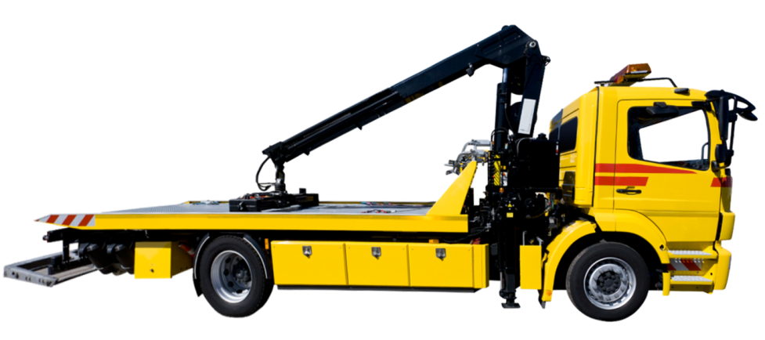
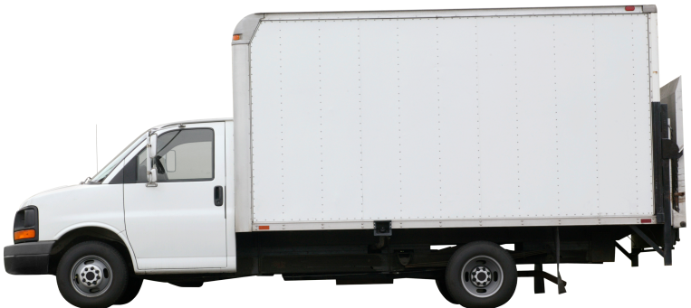
Roadside Assistance
4x
Location
Notes:
Roadside Assistance
0. As well as vehicle diagnostics, Networkfleet also provides complimentary roadside assistance
1. When a driver encounters a problem such as requiring [choose two or three - Towing, locksmith service, battery boost, flat repair, fuel delivery, winch or roadside assistance]
2. The vehicle diagnostics and GPS tracking make things far easier for drivers; so if a vehicle does have problems, at least things are as easy as possible for those driving them
3. The diagnostic and location information is communicated wirelessly.
4. Making it really easy for you to dispatch support and resolve the issue
5. As part of the service Networkfleet provides 4 calls per calendar year per vehicle - complimentary

Slide 12
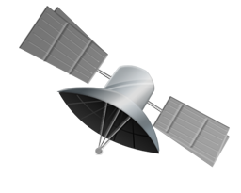
Networkfleet Solution
Easy to install
In-vehicle hardware
Automatic vehicle location technology
Secure wireless network
SMS/Text alert
Export data
Notes:
Networkfleet Solution
0. Networkfleet uses in-vehicle hardware, and a web-based application to view data. Each vehicle is equipped with GPS technology, which is easily installed
1.And this device sends information to the Networkfleet Data Center
2. over a secure wireless network
Fleet operators can access their fleet, securely online, where they receive location and route updates as well as periodic engine performance updates
3. If configured, SMS alerts are sent when certain pre-listed events occur
Comprehensive reports can be used to gain oversight of the fleet
4. And that data can be integrated with other applications
[In-Vehicle Hardware
No splicing
Plug-and-play
Tamper resistance capabilities
Nationwide wireless coverage
Models
5500 – Reliable GPS tracking WITH remote diagnostics
5200 – Reliable GPS tracking only
Integrates with Garmin navigation devices: Turn-by-turn navigation to jobs, Jobs management, Two-way driver messaging]

Slide 13
Management Reports & Activity Alerts
Fleet location
Greenhouse emissions
Fleet utilization
Landmarks
Smog check
Fuel usage & MPG
Odd hours
Stop detail
Geofence violation
Speed violations
Idle time
Notes:
Management Reports
0. With Networkfleet, it's easy to run or schedule reports on your whole fleet, individual vehicles, or groups of vehicles
Reports on:
Fleet Location Report, Fleet Utilization Report, Fuel Usage and MPG Report, Geo-Fence Violation Report, Greenhouse Emissions Report, Landmark Reports, Odd-Hours Report, Speed Violations Report, Smog Check Report, Stop Detail and Idle Time Report

Slide 14
Integrations
Fleet telematics
Other systems
Live data
Geographic
Networkfleet
Notes:
Integrations
1. Networkfleet integrates with other systems, including ESRI and Asset Works - making things easier for those using these platforms
2. Networkfleet integrates with Asset Works; allows maintenance to be scheduled using actual live data from vehicle diagnostics
3. Networkfleet integrates with ESRI, allowing fleet managers to take advantage of Geographic information systems

Slide 15
Evolving Technology
Future proof solution
Networkfleet
Notes:
Future-Proof
0. With Verizon backing, Networkfleet has the ability to scale significantly, and to invest to ensure that the product remains superior, which ensures that Networkfleet's product roadmap is not only exciting now, but will continue to develop in line with your requirements and industry best-practice
[Able to grow with customers as required
Able to invest in product development, engineering
Able to develop new ways for systems and data to be integrated
Customers get the security of selecting a supplier that is well-funded and that will be able to continue to grow]

