Slide 1

PFSA
GPS Insight

Slide 2





GPS Insight: Telematics Solution
How can we help you reduce costs of running your fleet
Efficiency
Productivity
Customer Service
Community Value
Notes:
GPS Insight Standard gives you the best of both worlds—simplicity and quick access using the same power behind an enterprise solution that gives you the data you want when you want it.
You don’t have to spend a lot of time learning how to use the product and can start using it right away. For example, you can know about driver behavior issues as they are happening and also send a message to the driver telling them to slow down or shut the vehicle off. We can send reminders to you, the service department, and/or the drivers letting them know that their vehicle is due for service. You can also dispatch more efficiently, cut fuel and labor costs, increase safety, improve customer service, and so much more.

Slide 3

Efficiency
Reduce Idle Stop Times
Reduce Fuel Slippage
Optimize Fleet
Reduce Miles Driven
Manage Off Hours Usage
Reduce Costs of Speeding
Extend Fleet Lifetime
More…

Slide 4

Productivity
Increase Locations Visited
Improve Vehicle Routing
Limit Unauthorized Stops
Monitor Time Spent at a Location
More…

Slide 5

Customer Service
Increase Response Times
Find Closest Vehicle for Dispatch
Provide Transparency into Location
Prove Service was done
More…

Slide 6

Community Value?
Reduce GHG Emissions
Monitor Hybrids & EV’s
Reduce Risk and Liability
Increase Driver Safety
More…

Slide 7


Go Green!
Reliable Tracking on
Hybrids / Plug-In Hybrids / EV’s
via Device‑Level Scripting
Maintains a continuous trip when physical and/or electronic movement* occurs within two minutes.
*Movement includes:
1) An increase in voltage
2) Physical movement, such as creeping forward
3) Movement based on the accelerometer.
Notes:
Most providers’ data captures ignition status change events only. Because alternative vehicle engines shut off when stopped, at a red light for example, their data would show that a driver’s trip ended in the middle of the road, when in reality that isn’t true. GPS Insight’s data, on the other hand, shows true trip activity because our device logic allows us to accommodate various voltage variables present on the ECM/ECU in alternative vehicles. Our data would show that the vehicle was indeed stopped, but that the trip is still in progress and stopped at a red light. We also can provide accurate data for when the ignition is truly off.

Slide 8


Since 2004 • HQ Scottsdale, AZ • Tracking 100,000+ Vehicles & Assets
We want to improve your business through INCREASED REVENUE, REDUCED COSTS, and REDUCED RISK.

Slide 9

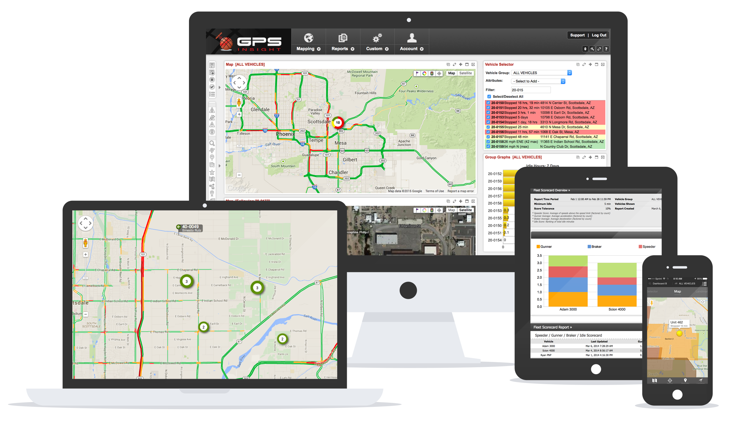
Award-Winning software
Notes:
Our GPS Insight Standard product has a really simple interface, which you can access from almost any device.

Slide 10
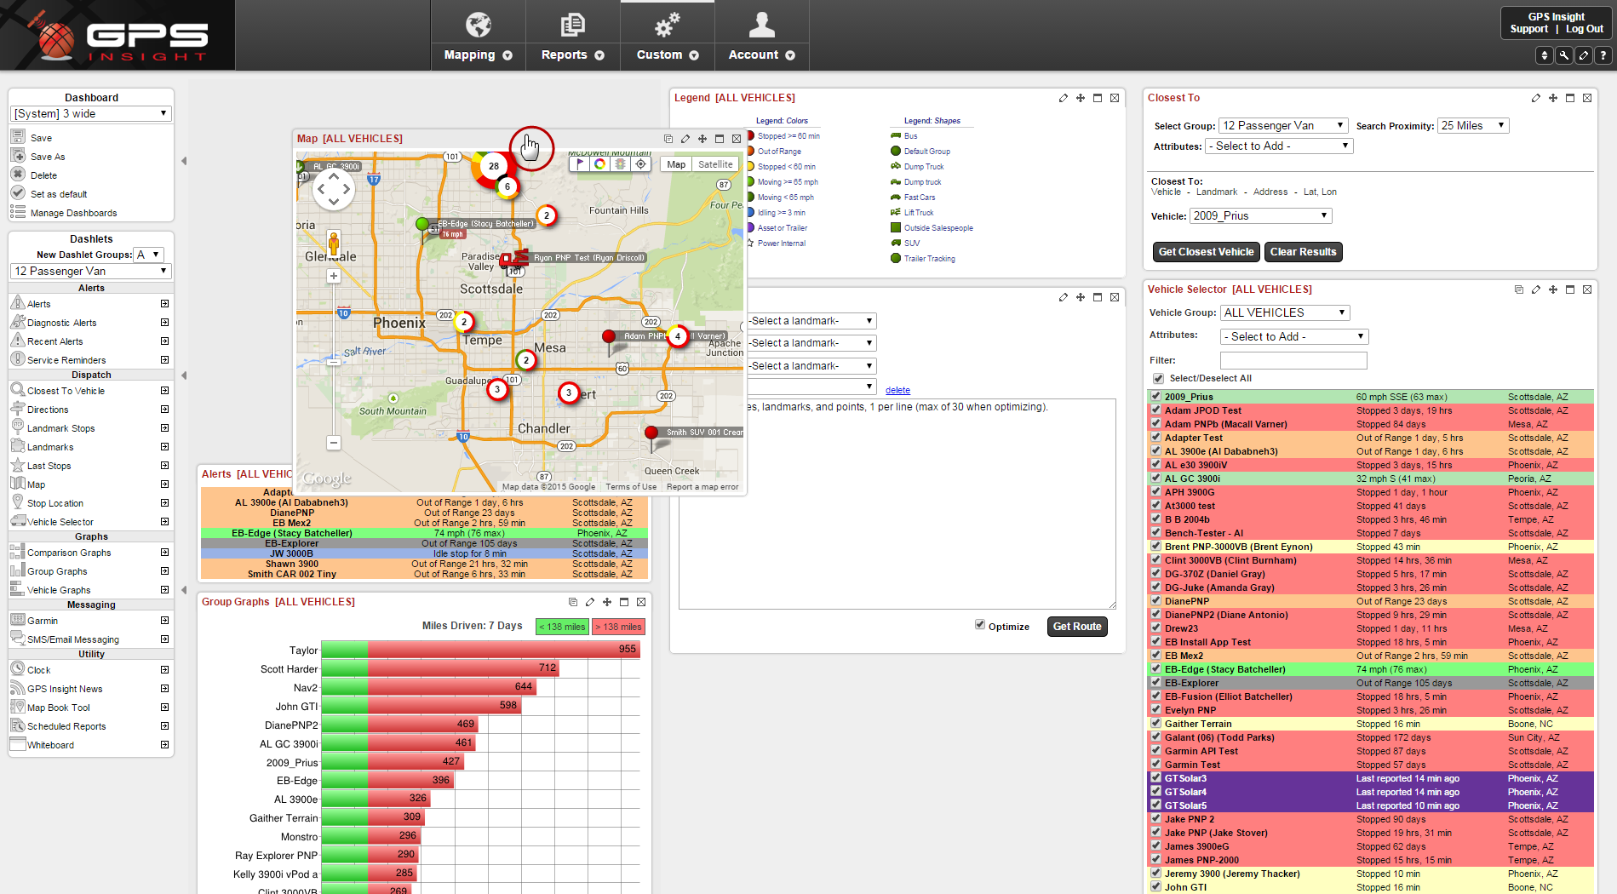
Dashboard Interface
Customize and save multiple layouts (e.g., Dispatching, Analytics, etc.)
30+ configurable drag-and-drop dashlets are available

Slide 11
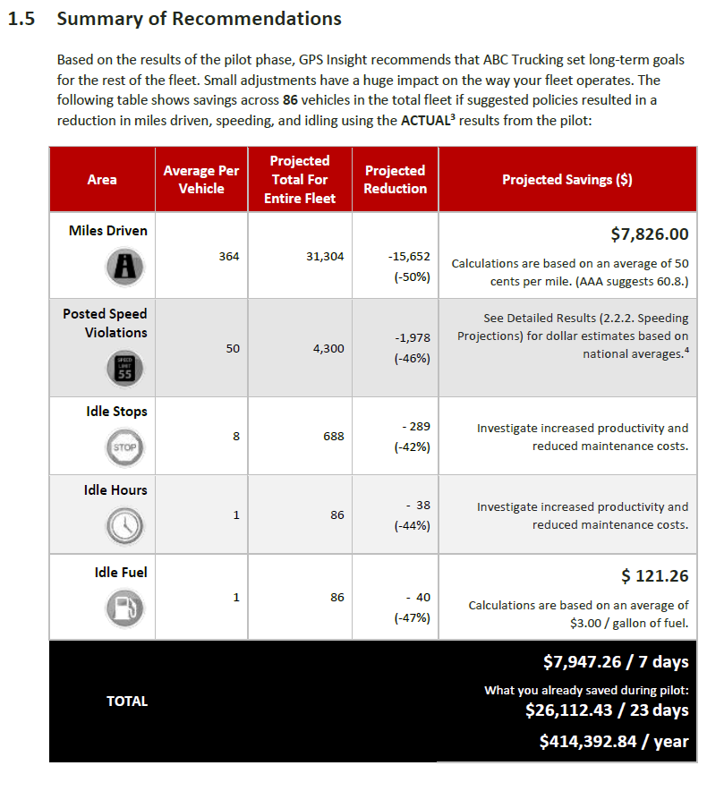
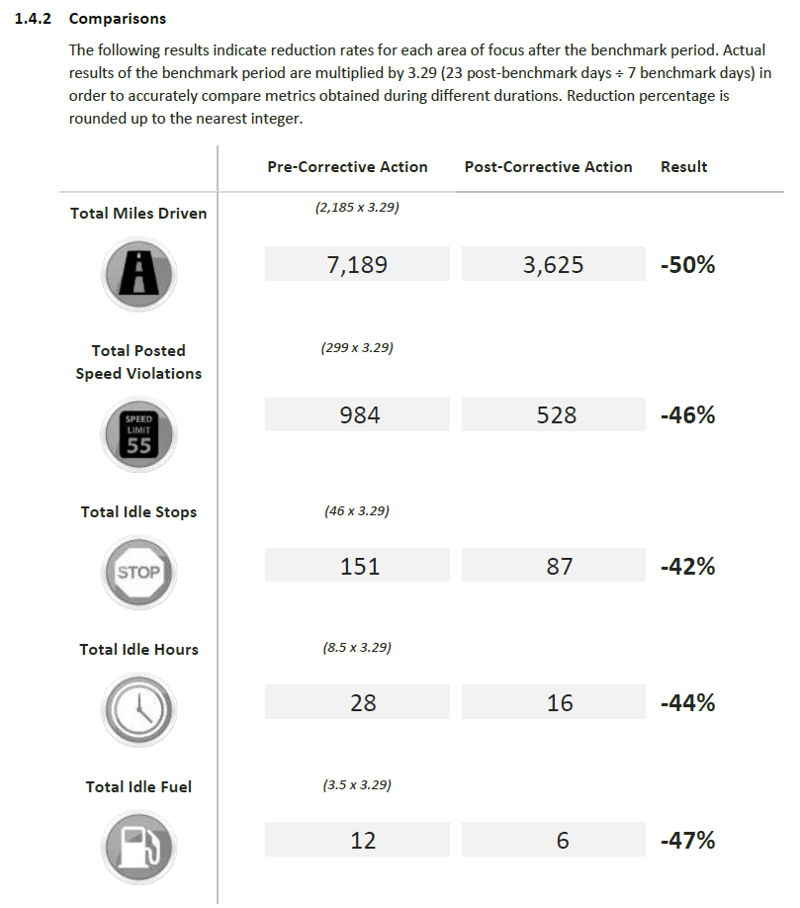
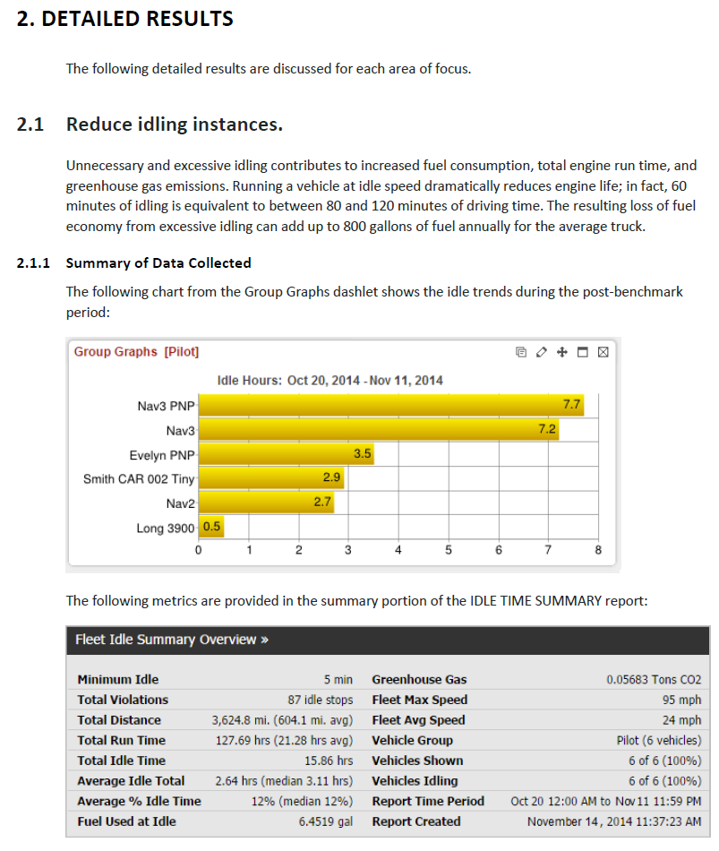
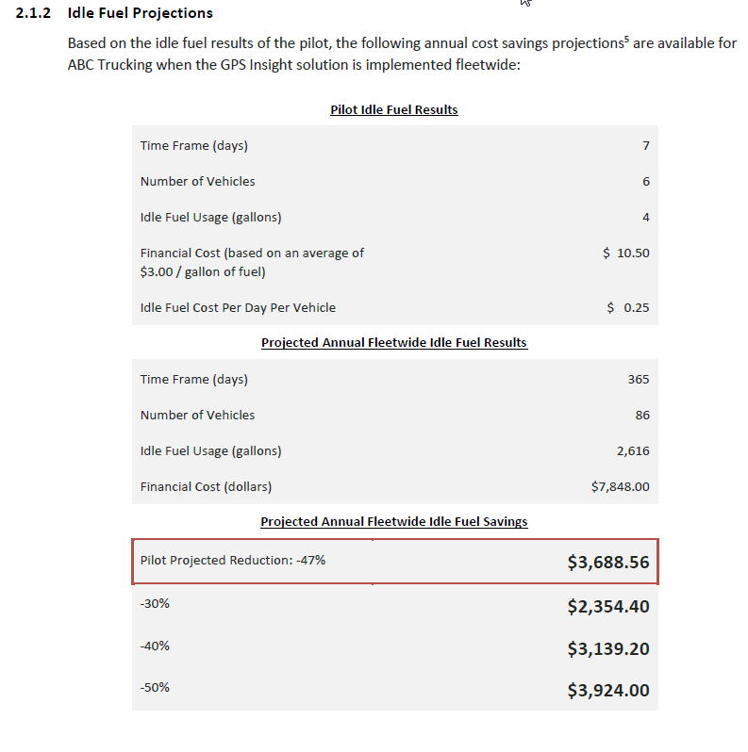
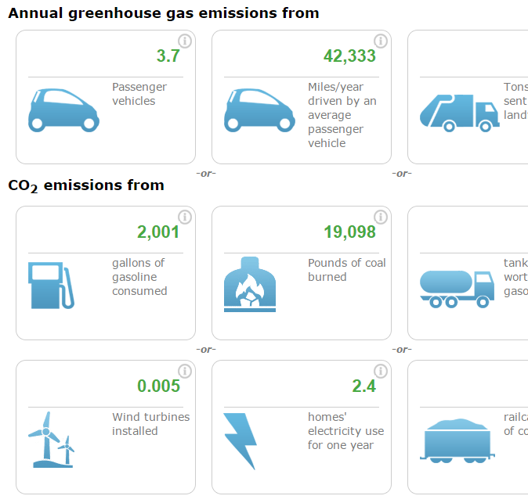
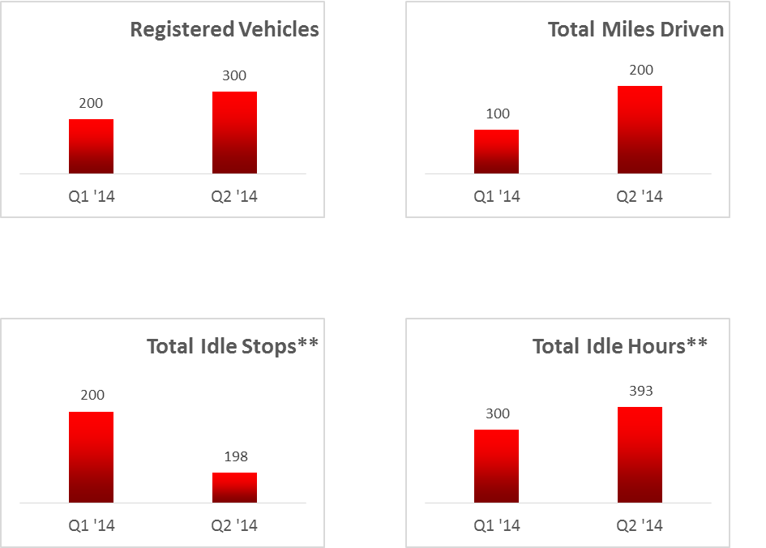
We help you analyze the data, too!
In addition to 40+ included reports.

Slide 12
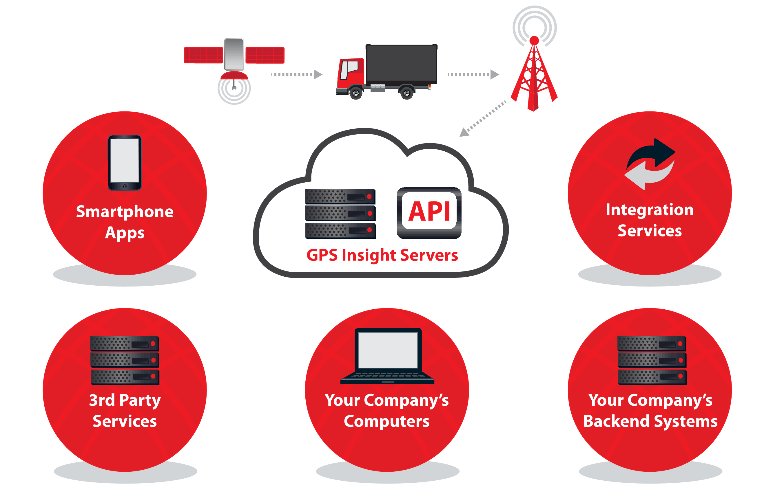
Integration (APIs) Included
Notes:
We also offer custom integrations with your in-house software applications via our APIs. These APIs allow you to push your fleet’s data from our system to your back-end systems, which might include anything from ERP, Dispatch, CRM, payroll, asset management, and so on. We are very flexible when it comes to modifying our APIs and have created many custom fields for our customers.

Slide 13

GPS Insight offers a FREE pilot to gather baseline data for your fleet for 90 days…
Notes:
We provide this industry-leading product at a very affordable price point which we will get into. The cost per vehicle/asset is low enough that it doesn’t take more than a month or two to see a full ROI.

Slide 14


THANK YOU!
QUESTIONS?
info@gpsinsight.com
866-477-4321
gpsinsight.com

