Slide 1
Generator Rules and Regulation City of Livermore
Bay Area Air Quality Management District
375 Beale Street Suite 600
San Francisco, California 94105
Peter Nelson
Senior Air Quality Inspector

Slide 2
Regulation 9 Rule 8 NITROGEN OXIDES AND CARBON MONOXIDE FROM STATIONARY INTERNAL COMBUSTION ENGINES
9-8-101 Description: This rule limits the emissions of nitrogen oxides and carbon monoxide from stationary internal combustion engines with an output rated by the manufacturer at more than 50 brake horsepower
9-8-110 Exemptions: The requirements of Sections 9-8-301 through 305, 501 and 503 shall not apply to the following:
110.1 Until January 1, 2012, engines rated by the manufacturer at less than 250 brake horsepower output rating.
110.2 Engines rated by the manufacturer at 50 brake horsepower output rating or less. Effective January 1, 2012.
110.3 Until January 1, 2012, engines fired exclusively by liquid fuels including, but not limited to, diesel fuel, gasoline, and methanol.
110.4 Engines used directly and exclusively for the growing of crops or the raising of animals.
110.5 Emergency standby engines.
9-8-112 Registered Portable Equipment: The requirements of this section shall not apply to an internal combustion engine registered as portable pursuant to the Statewide Portable Engine and Equipment Registration Program, Sections 2450-2465, Article 5, Title 13, California Code of Regulations.

Slide 3
9-8-330 Emergency Standby Engines, Hours of Operation: A person may only operate an emergency standby engine under the following circumstances:
330.1 For emergency use for an unlimited number of hours; and
330.2 Until January 1, 2012, for reliability-related activities so long as total hours of operation for this purpose do not exceed 100 hours in a calendar year, or limitations contained in a District permit, whichever is lower.
330.3 Effective January 1, 2012, for reliability-related activities so long as total hours of operation for this purpose do not exceed 50 hours in a calendar year, or limitations contained in a District permit, whichever is lower. Hours of operation for reliability-related activities may exceed these limits only as necessary to comply with testing requirements of National Fire Protection Association (NFPA) 25 – “Standard for the Inspection, Testing, and Maintenance of Water-Based Fire Protection Systems,” 1998 edition.
9-8-530 Emergency Standby and Low Usage Engines, Monitoring and Recordkeeping: Each emergency standby and low usage engine shall be equipped with a nonresettable totalizing meter that measures hours of operation or fuel usage. All records shall be kept for at least two years, and shall be available for inspection by District staff upon request. The operator shall keep a monthly log of usage that shall indicate the following:
530.1 Hours of operation (total)
530.2 Hours of operation (emergency)
530.3 For each emergency, the nature of the emergency condition

Slide 4
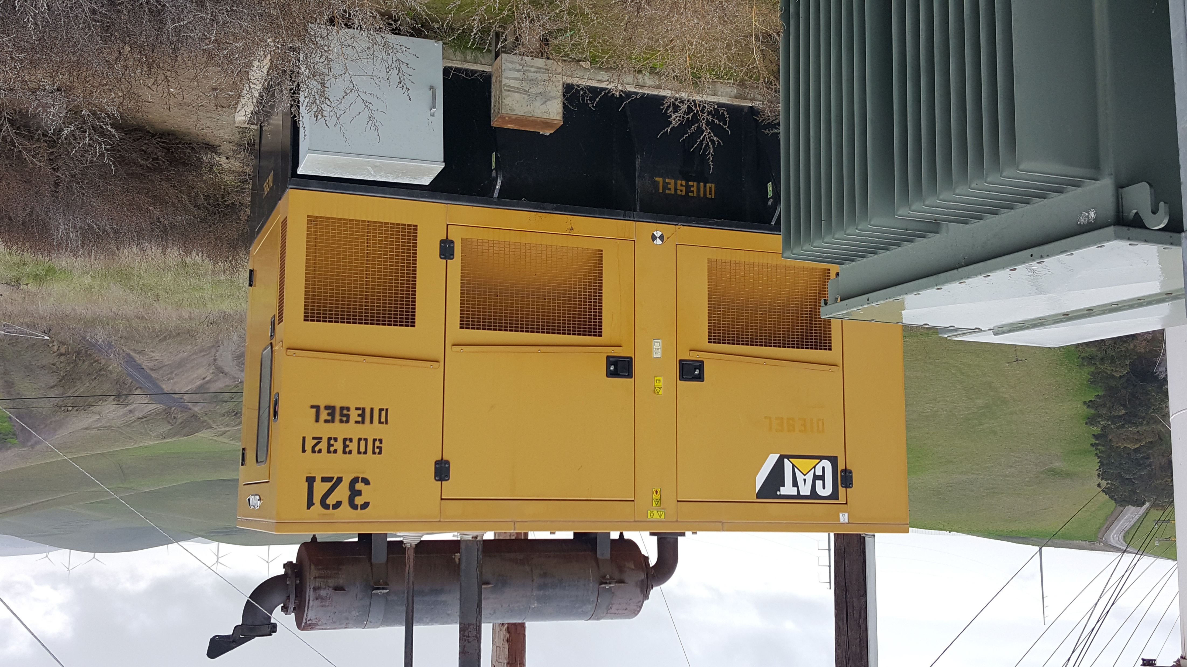

Slide 5
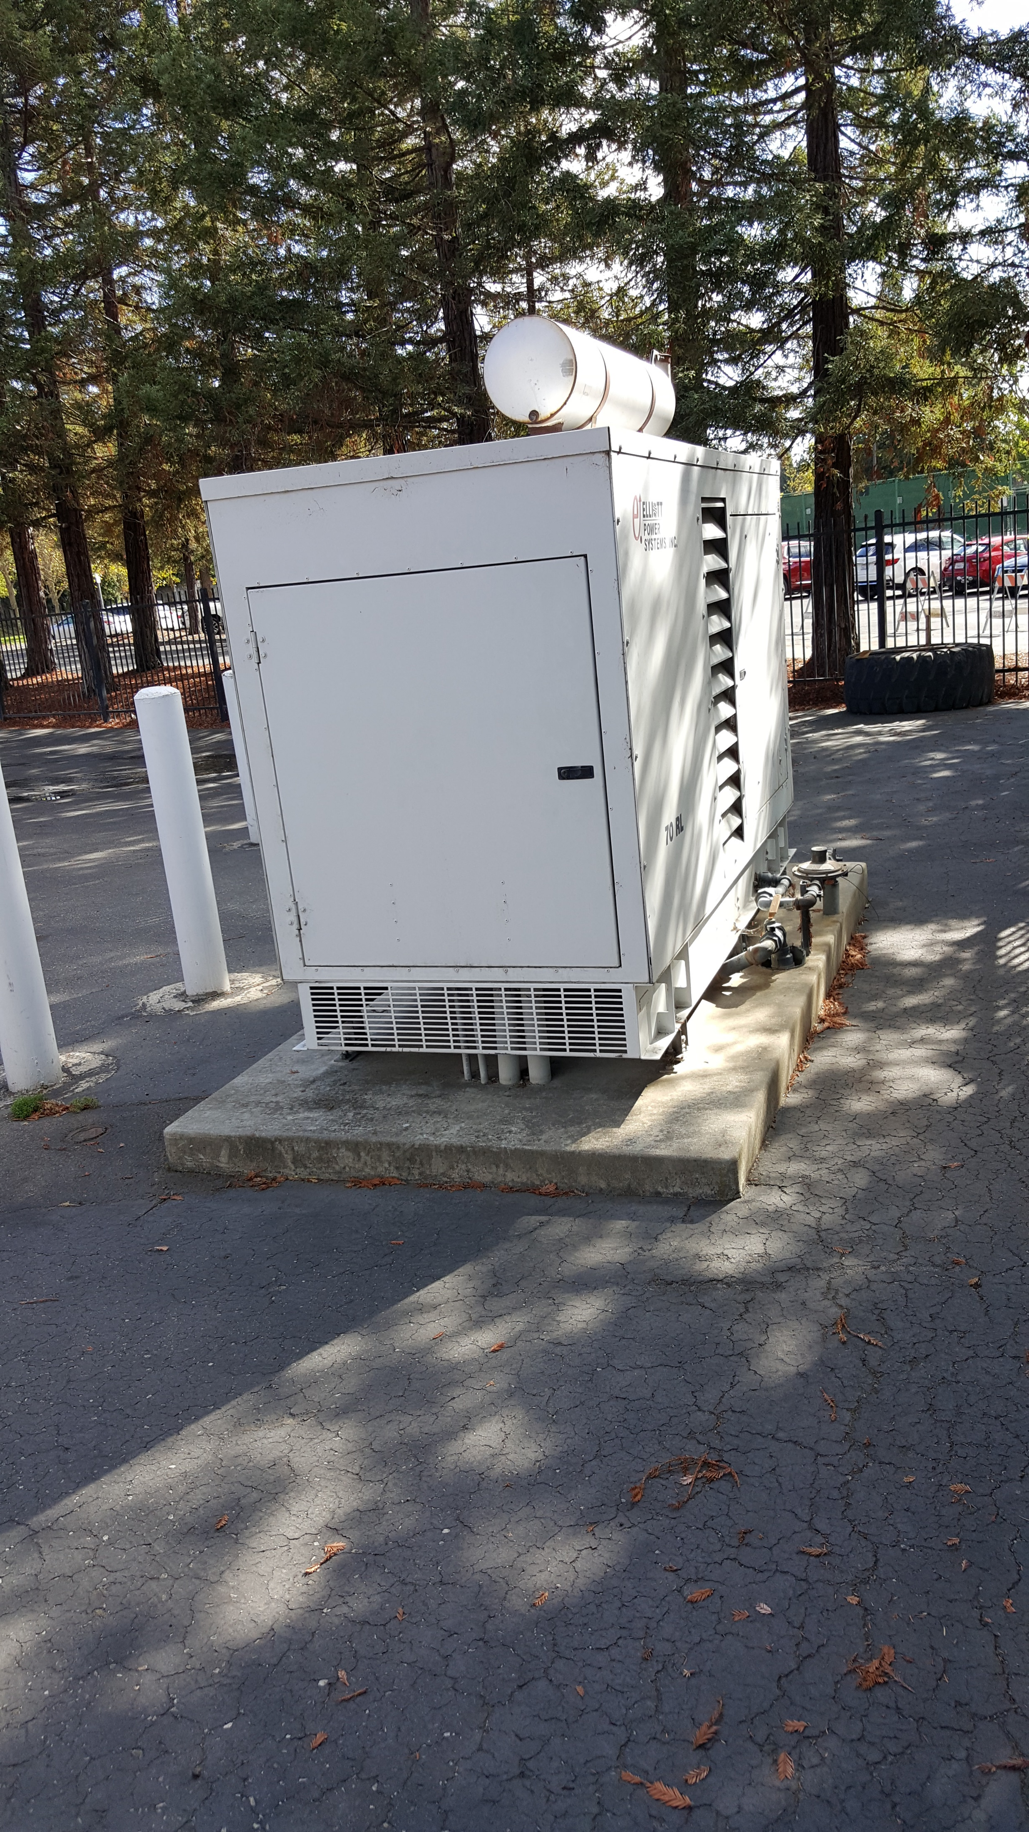

Slide 6
http://www.baaqmd.gov/permits/apply-for-a-permit

Slide 7
Questions and Answers

Slide 8
Peter Nelson 415 749-4979 pnelson@baaqmd.gov

